Slide 1

Predicting California Housing Prices
Mikhail Zaatra
Dawit Daniel Alaro
Srividhya Thirumalairajan
Trong Quyen Nguyen

Slide 2
AGENDA
Project Overview:
Topic and motivation
Project goals: Questions the team hopes to answer.
Technologies, languages, tools, and algorithms used throughout the project
Description of the source of data
Data exploration & transformation
Project analysis
Final Project outcome , Dashboard and visualization
Recommendation for future analysis

Slide 3
PROJECT OVERVIEW
Motivation:
Housing prices are a hot topic, especially during the COVID-19 Pandemic
Our group is passionate about real estate investments and wanted to build Machine Learning Model to help homeowners and real estate investors to evaluate potential deals within California
Project overview:
We imported housing sale records as CSV formats, then we used Python Libraries and SQL to perform ETL process on the raw data. Once data has been loaded we built a supervised Linear regression and Neural network MLs to predict the housing prices.
Project goals: Questions the team hopes to answer:
Can we predict the average housing prices and help consumers and real estate investors to make educated decisions based on our results and predicted housing prices?

Slide 4
TECHNOLOGIES, LANGUAGES, TOOLS, AND ALGORITHMS USED THROUGHOUT THE PROJECT
Python : Pandas, PySpark
SQLAlchemy
Postgres
Google CoLab
Google Docs.
Python ML Models: Linear regression , Keras for neural network ML Model.

Slide 5

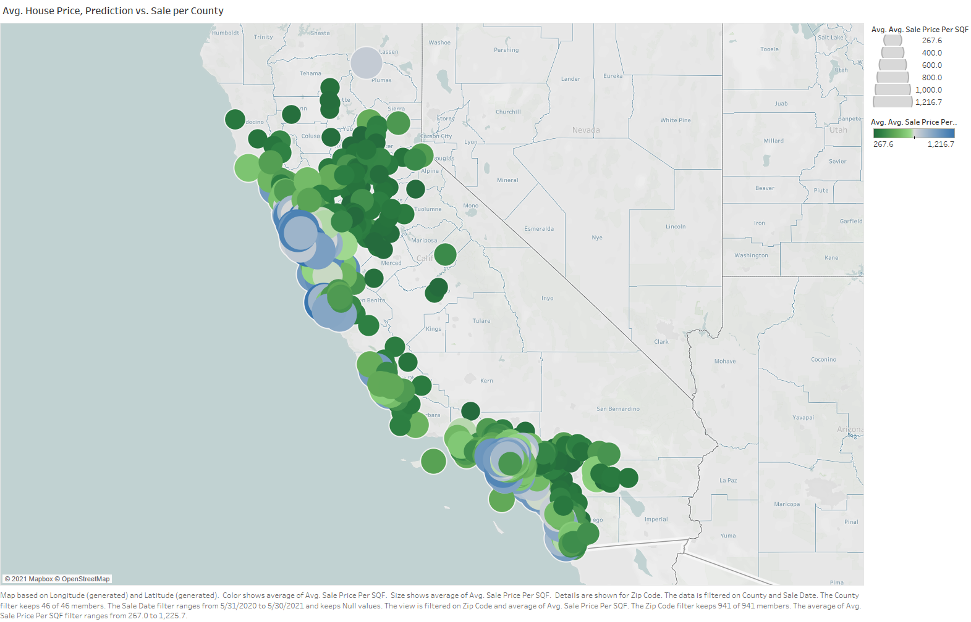

Data Exploration and Transformation
Upload the Raw Data via AWS
Data Wrangling
Results
Visualization & Analysis
Cleaned and unified the messy and complex data sets for easy access and analysis
Able to produce following clean data sets for our machine learning models
Final_data.csv, house_data.csv, Sale_date.csv
Notes:
Python : Pandas, PySpark
SQLAlchemy
Postgres
Google CoLab
Google Docs.
Python ML Models: Linear regression , Keras for neural network ML Model.

Slide 6
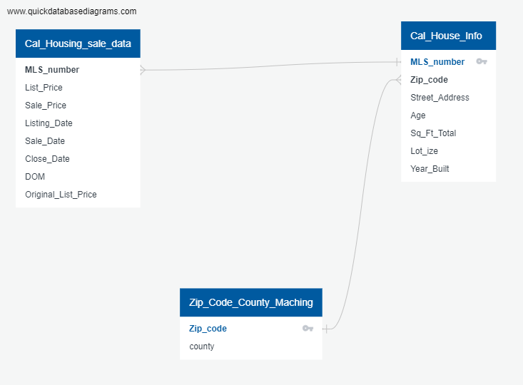
Data Processing Method
Build ERDs
create new tables
Houseing_Sale_data
House_info
County_info
Dawit Alaro

Slide 7
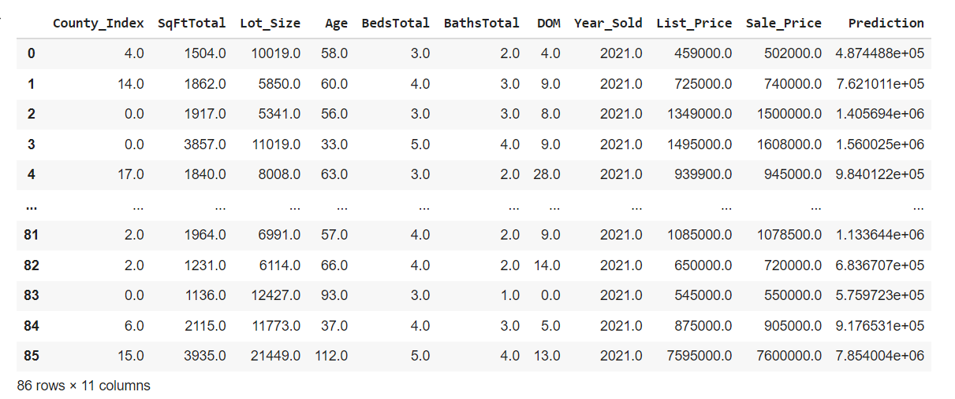
Data Processing
Pyspark and AWS
Transform String columns
Merge
Select columns
Drop nulls values
Lot size >= 800 SqFt
Load to PostgreSql(three table)
Clean Data with Regression prediction
Dawit Alaro

Slide 8
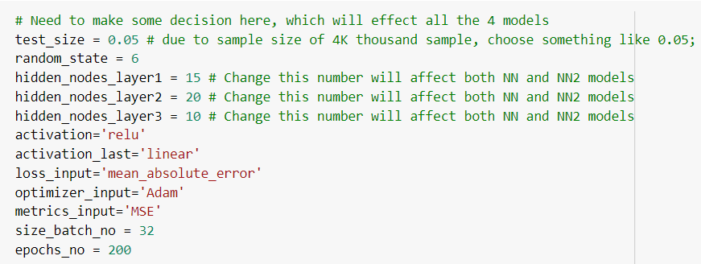
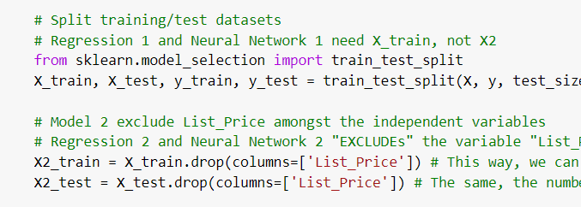
Connection,
Regression,
Neural network,
Random Forest
TrongQuyen Nguyen

Slide 9
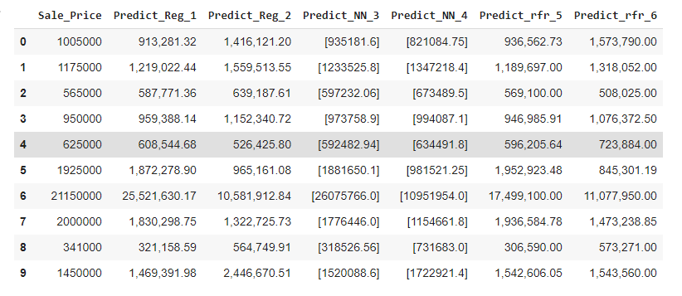
Connection,
Regression,
Neural network, Random Forest
Examples of the prediction values
TrongQuyen Nguyen

Slide 10
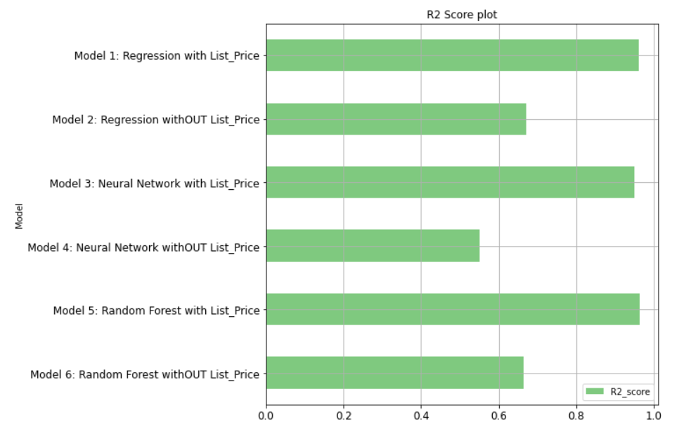
Connection,
Regression,
Neural network, Random Forest
TrongQuyen Nguyen
With “List_Price”, R2_score is the higher than without

Slide 11
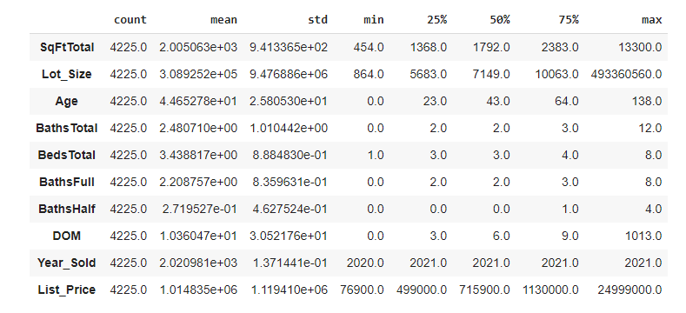
Connection,
Regression,
Neural network, Random Forest
TrongQuyen Nguyen
‘List_Price’ as a quality parameter

Slide 12
KEY TAKEAWAYS AND RECOMMENDATIONS
Summary:
In this project we created a powerful tool for Reals estate investors and potential home Buyers to Make educated and Data Driven Decisions when it comes to real estate Purchase:
They Can decide in which county & City they want to live (Based on Affordability).
Then they can decide on the Size of the House & Number of Bedrooms.
Using Linear Regression to predict Housing Prices provides good prediction with over 90% R - squared value.
Recommendations:
For Future projects, We could enhance the housing price prediction Model by using a deep learning model that uses the the time as Independent variable
We could extended this Model to Take Household Income, school Rating, and other layer that might impact the Housing Prices.
This model could be extended to be in use Nationwide. We could up level it to start from the state then drill down to county and they to the City level. .

Slide 13
Thank you!

Slide 14
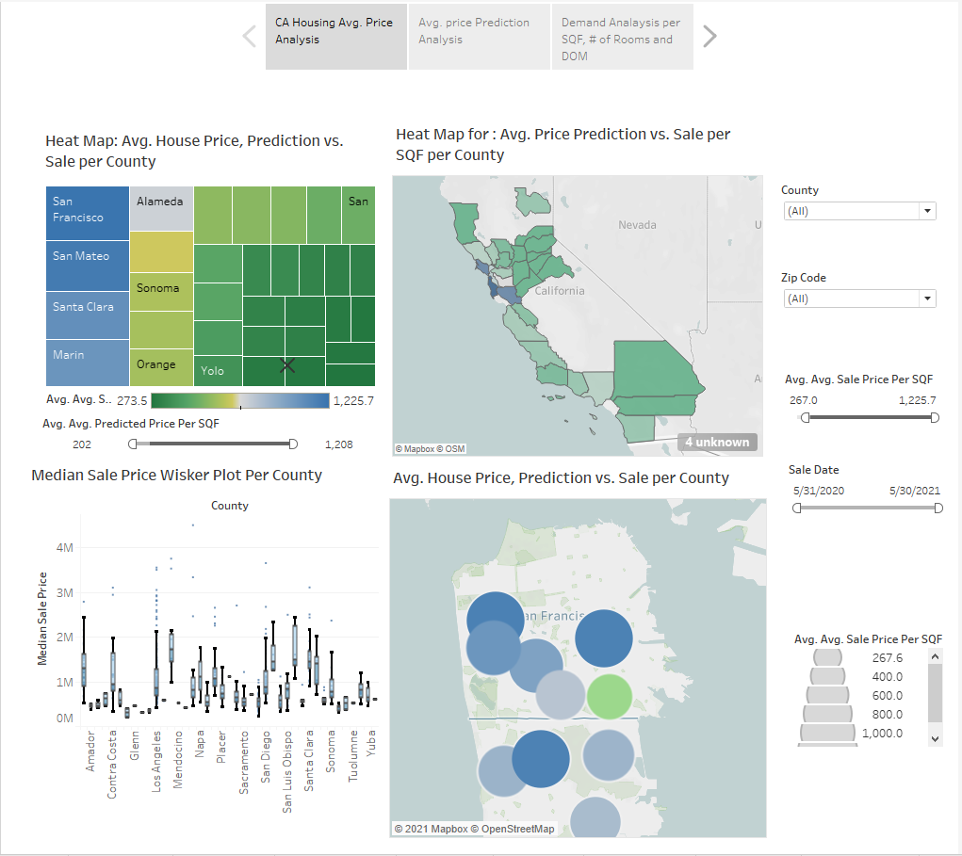
DASHBOARD AND VISUALIZATION USING TABLEAU
HOUSING HEAT MAPS PER AvG. PRICES
The following Dashboard present:
Heat Map for Avg. price Per County (Blue is the Highest Avg. Price).
Heat Map of Avg. Price Per SQF for each County
Heat Map of Avg. Price Per SQF for each Zip Code
Whisker Plot chart to show the Price distribution between the 4 quartiles

Slide 15
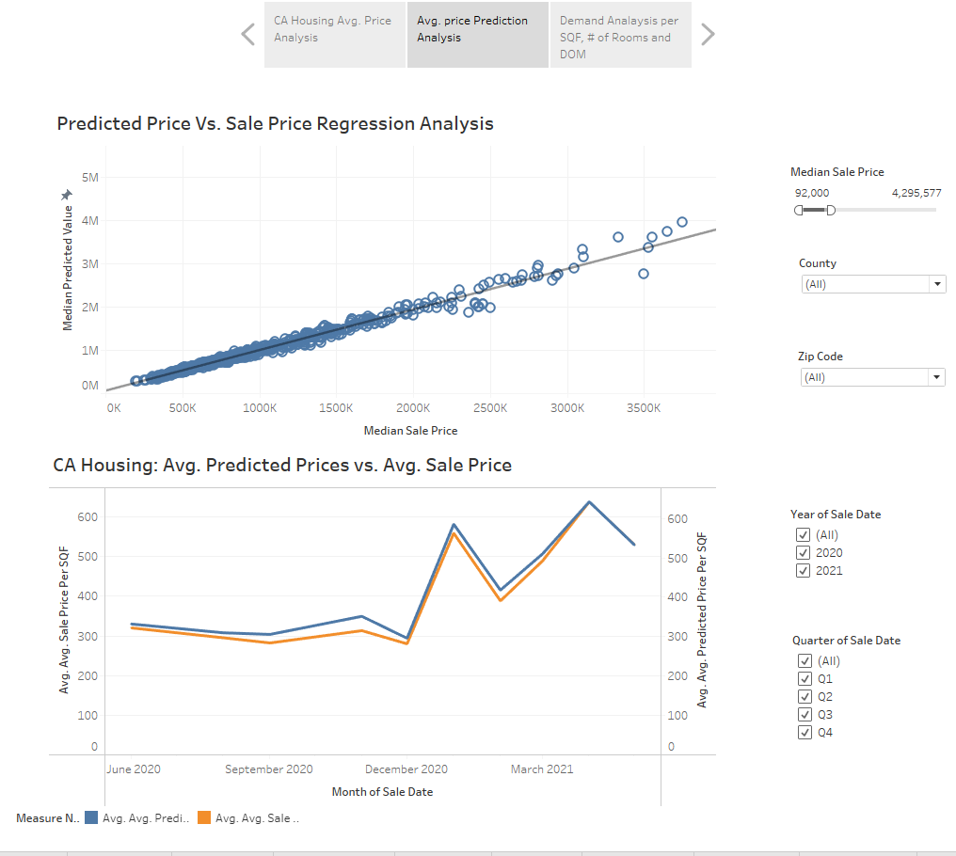
HOUSE PRICING REGRESSION CHARTS
In this Dashboard present :
Sale Price vs. Predicted Price Based on the Linear Regression Model.

Slide 16
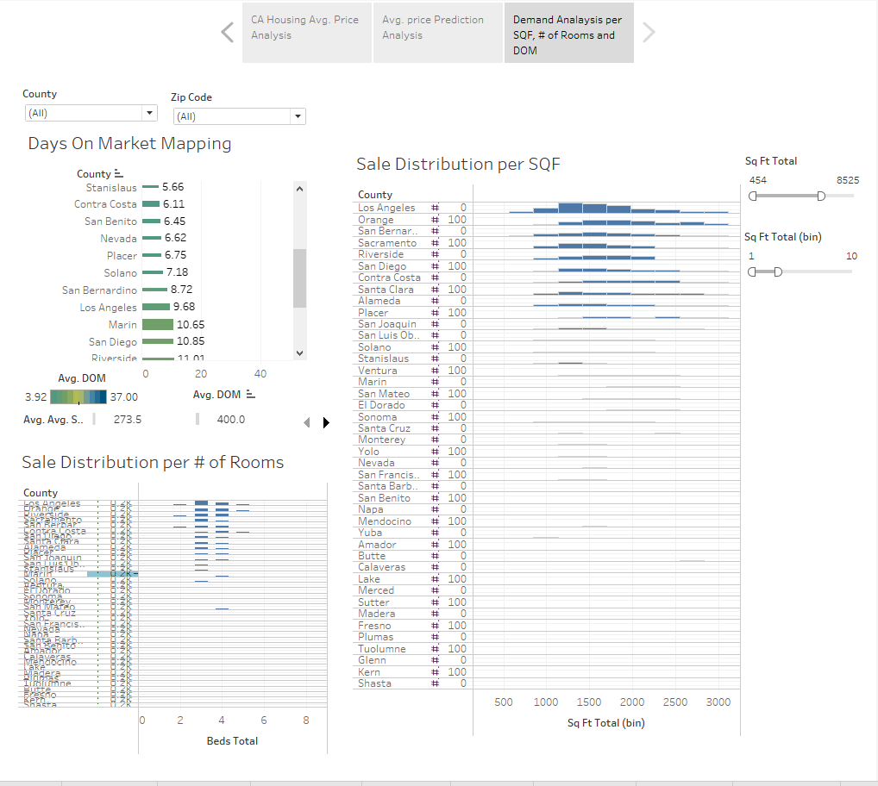
HOUSING ANALYSIS DRILL DOWN
This Dashboard present :
Days on Market Mapping : Avg. Number of Days from Publish to Close .
Sale Distribution Per SQF: Distribution of House sales transactions per SQF.
Sale Distribution per # of rooms shows the distribution of House sales transactions per # of rooms.

Slide 17
Additional Sources

Slide 18
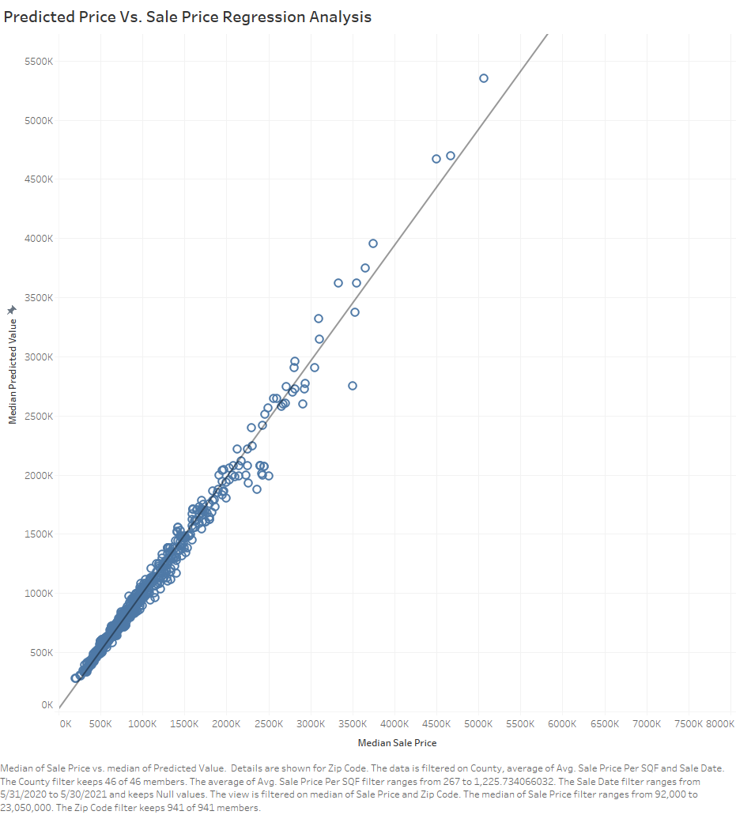

Slide 19
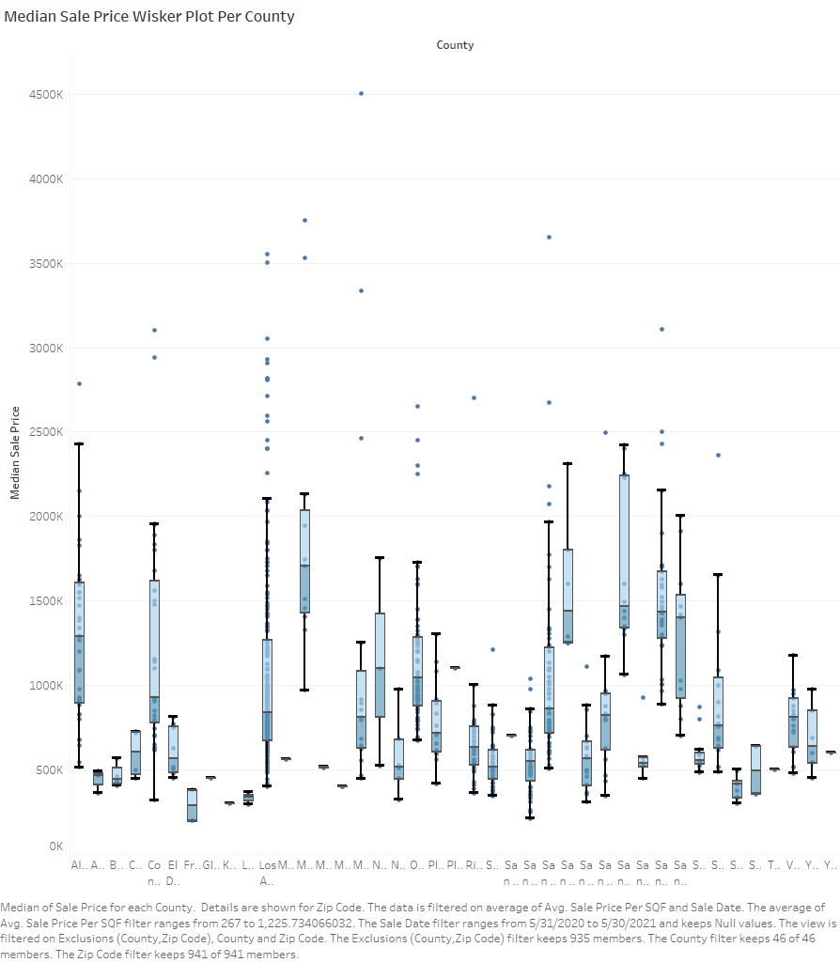

Slide 20
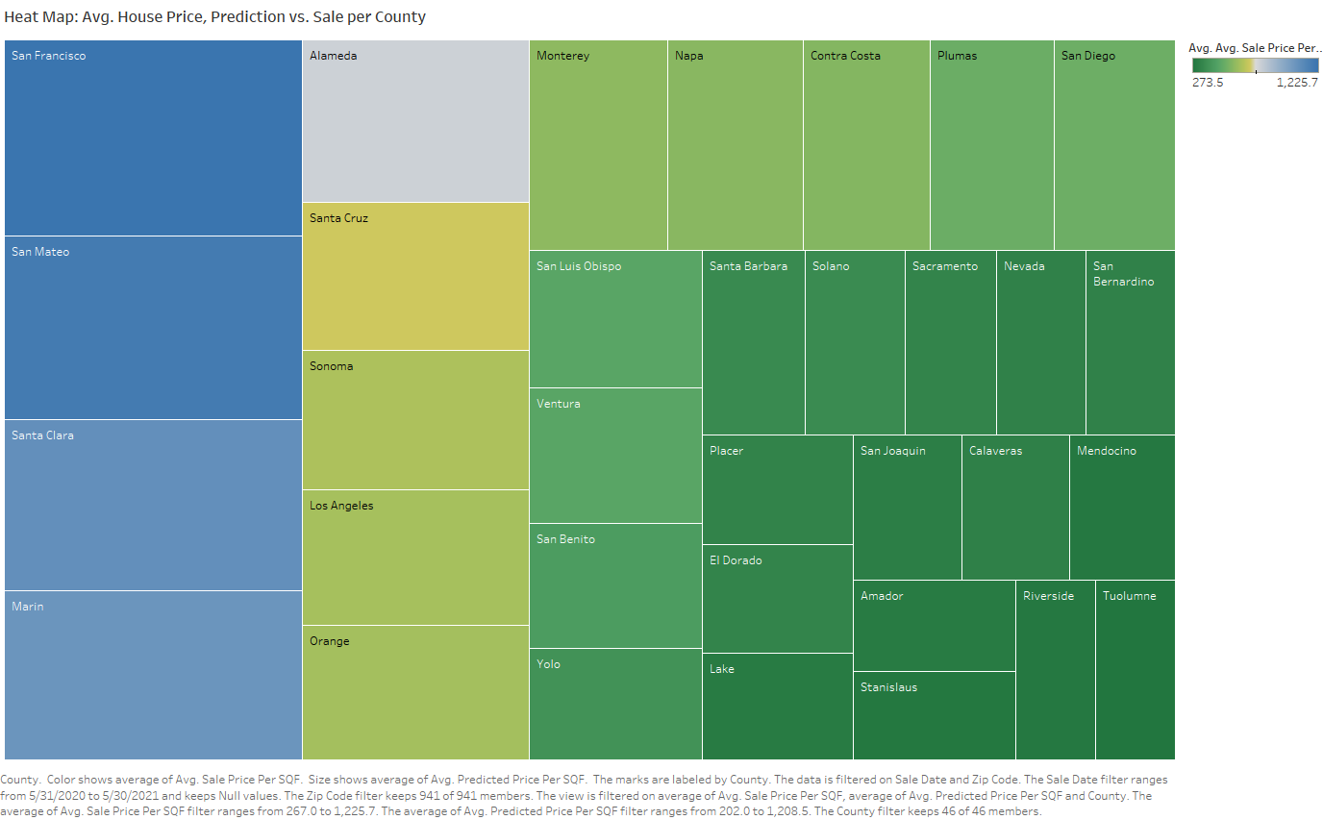

Slide 21
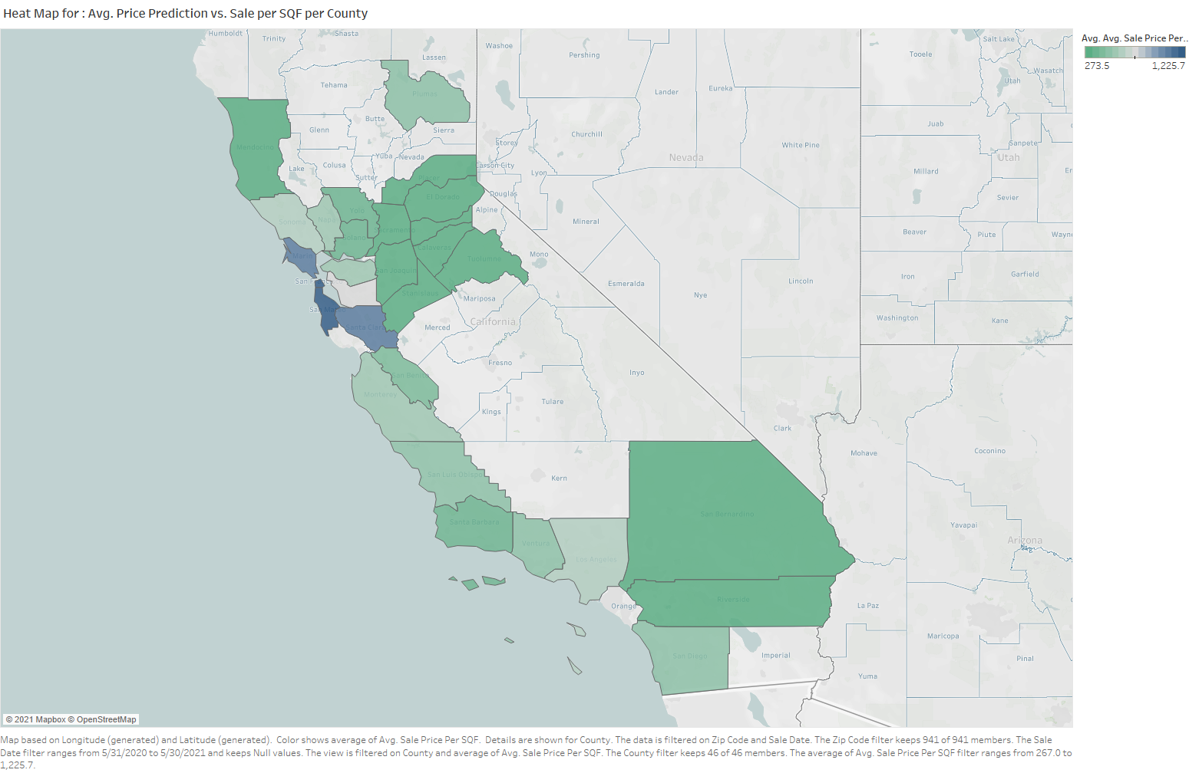

Slide 23
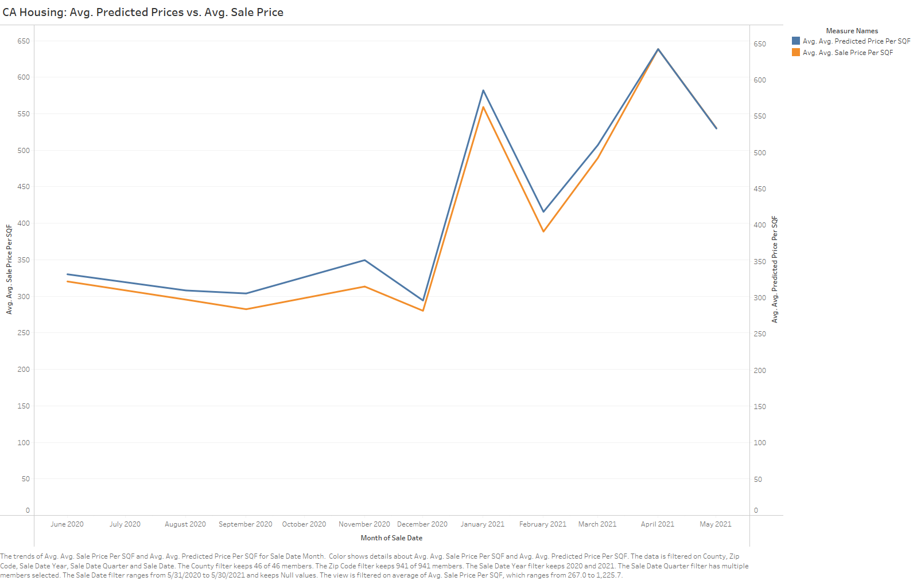

Slide 24
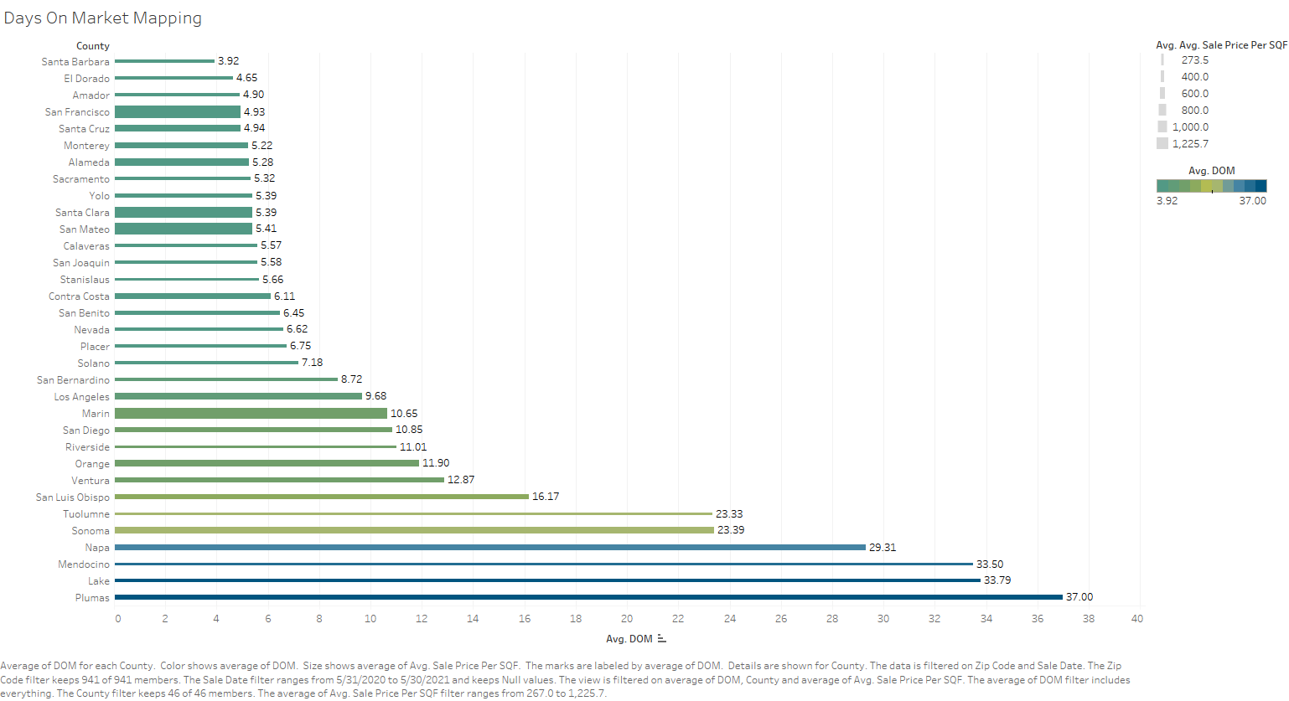

Slide 25
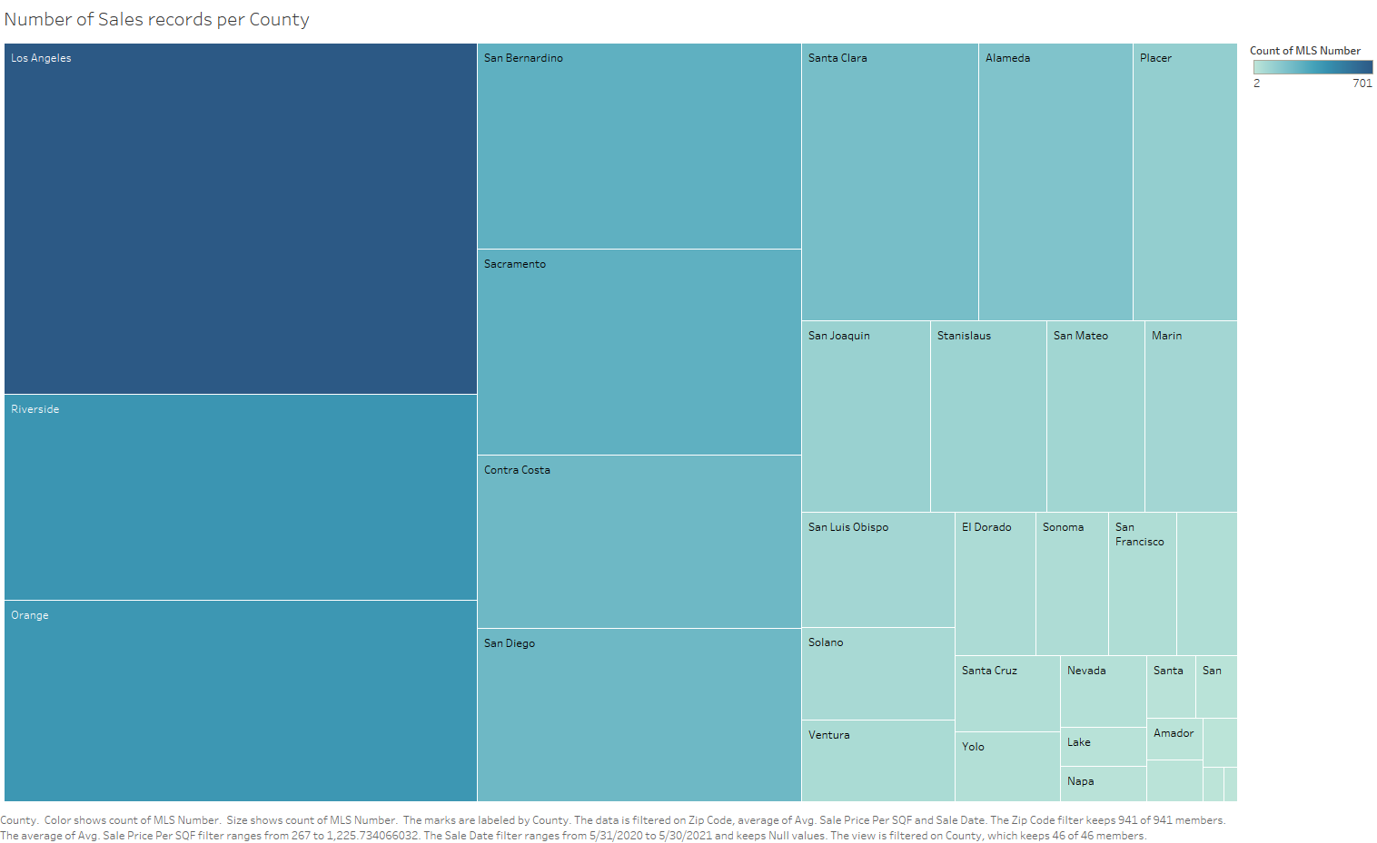

Slide 26
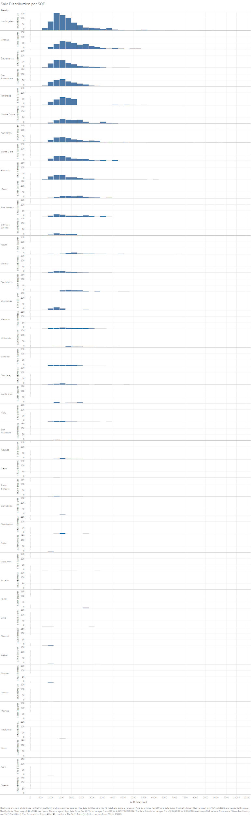

Slide 27
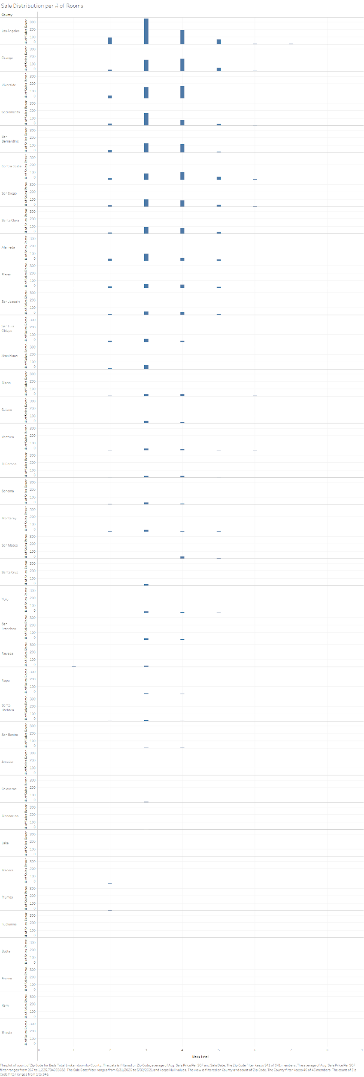

Slide 28
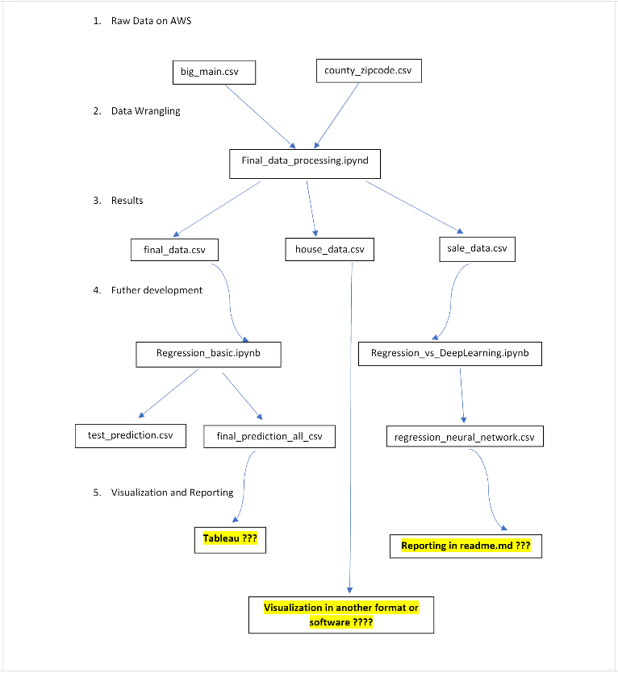

Slide 29
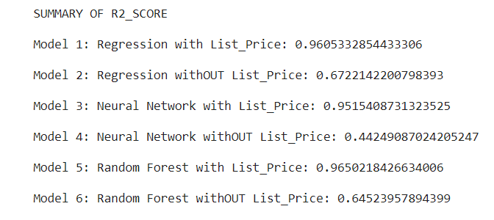
Connection,
Regression,
Neural network, Random Forest
TrongQuyen Nguyen
With “List_Price” R2_score is the higher than without

